Slide 1
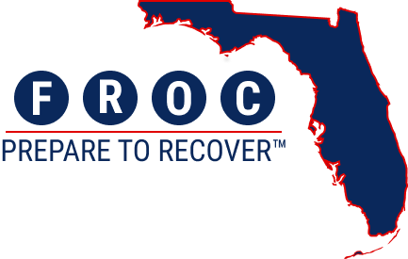
F-ROCkstar Toolkit

Slide 2
Purpose of this document
The purpose of this slide deck is to help you facilitate any conversations you may be having with others in your organization. It walks through the F-ROC journey, beginning after opt-in all the way through abatement and the Post Disaster Questionnaire.
This document was created September 2024. As the program evolves, we will update this document if anything changes.
If anything changes, we will distribute updated versions via the F-ROC communications and the F-ROC website.

Slide 3


Welcome to F-ROC!
We’re so glad you’re here! If you’re reading this, that means you have officially opted into F-ROC for the 2025/2026 season!
We’d like to thank you for your dedication to Public Assistance and being a part of the future of recovery in Florida.
You may be thinking, what is a F-ROCkstar toolkit?
This toolkit is intended to enable you with tools and resources that will support you on your F-ROC journey. From tailored guides, to training materials, to key contact information, consider this a playbook of resources to help you get the most out of F-ROC, with dedicated resources at each key milestone.

Slide 4
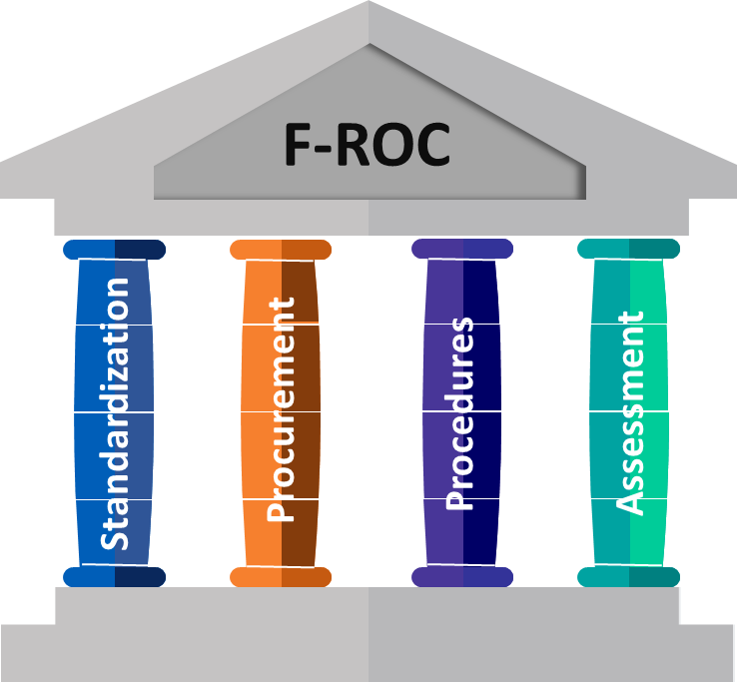
How F-ROC Changes Public Assistance
F-ROC addresses current-state challenges by encouraging a proactive and streamlined approach to recovery, reducing risk, and implementing measures that enhance Applicants’ ability to successfully navigate the Public Assistance process.
PILLAR 1: STANDARDIZATION
PILLAR 3: PROCEDURES
F-ROC standardizes and simplifies forms, making it easier to submit accurate documentation for Public Assistance and receive funding timely.
F-ROC helps you prepare for events by ensuring you have policies and procedures that are accurate, up-to-date, and follow FEMA guidelines.
PILLAR 2: PROCUREMENT
PILLAR 4: ASSESSMENT
F-ROC helps you to ensure goods and services are procured in accordance with your procurement policy, and your policy meets appropriate federal regulations.
The Disaster Readiness Assessment provides you with the insights needed to be successful. Applicants who employ all four pillars of the program can receive up to 85% of funding upon obligation.

Slide 5



F-ROC Milestones
The timeline below depicts the various milestones that you will navigate on your F-ROC journey. At each milestone, we have dedicated resources and contacts to ensure you are supported.
Opt-In Deadline
(8/31)
Opt-In period closes. You have until this date to opt in for the 2025 hurricane season. To be considered fully opted-in, you must:
Complete the F-ROC e-learning course.
Sign the participation request form.
Complete the 2025 DRA.
Abatement Activities Deadline (3/31)
Disaster Readiness Assessment Deadline (10/31)
Customized Abatement Plan Deadline (1/31)
Lock In Date for next season (6/1)
FDEM will review and approve your entity’s customized abatement plan. Once it is approved, you have until the abatement deadline to:
Complete the activities in your customized abatement plan.
Submit to FDEM for review.
After opting in, you will receive an email to initiate your account in Smart Grants, where you will complete your DRA. Before the DRA deadline, you need to:
Upload the relevant documentation in Smart Grants in accordance with your DRA responses.
Submit your DRA in Smart Grants.
To meet this milestone, you need to:
Review your DRA feedback.
Select from the proposed abatement activities what you plan to complete.
Submit to FDEM for approval.
By this date, FDEM will have reviewed and approved the abatement activities you submitted. You will receive your new F-ROC score, which equates to the amount that you receive upfront in events that occur in the following year.

Slide 6
F-ROC Scoring
The Florida Iceberg! Just like how most of an iceberg isn’t visible, the majority of PA funding can be received upfront through the F-ROC process.
Once validation of supporting documents is complete, you will receive the remainder of the validated, obligated amount
The maximum F-ROC score is 85. This score is made up of three components:
20
Post Disaster Questionnaire (F-ROC Forms and Training)
  With F-ROC, you can receive up to 85% Funding Upfront
50
Disaster Readiness Assessment
*5 bonus points can be earned with EMAP accreditation
10
Opt-In Baseline
*These points will be awarded upon completion of the DRA.

Slide 7
Disaster Readiness Assessment
MILESTONE OVERVIEW
The Disaster Readiness Assessment (DRA) is a questionnaire that aims to identify how well your organization is prepared to Recover. Completing the DRA provides you with the insights needed to be successful. All DRA questions are broken down into the following sections:
Applicant Experience
Policy and Procedure
Documentation
Procurement
Contract Administration
The DRA is completed in the KPMG Smart Grants platform. After opting in, you should receive an email from donotreply-fldrgs@managedgrants.com to initiate your account in Smart Grants.
TIMELINE
June 1
The F-ROC Program Opt-in Period opens and the Disaster Readiness Assessment (DRA) is now available on the Smart Grants platform. Once you Opt-in, you can begin to respond to the assessment.
To be scheduled
Keep an eye out for invitations from F-ROC Program Leadership on DRA Information Sessions.
October 31
Deadline for submitting the DRA in Smart Grants.

Slide 8
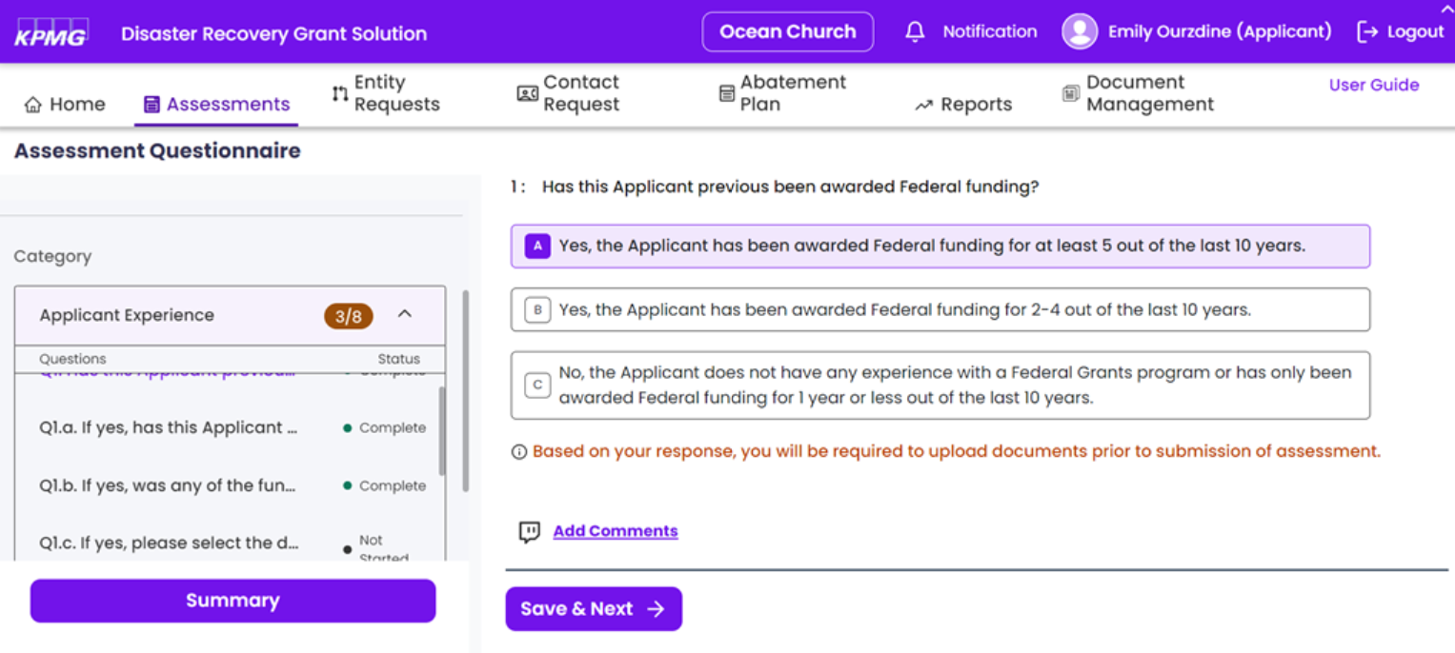
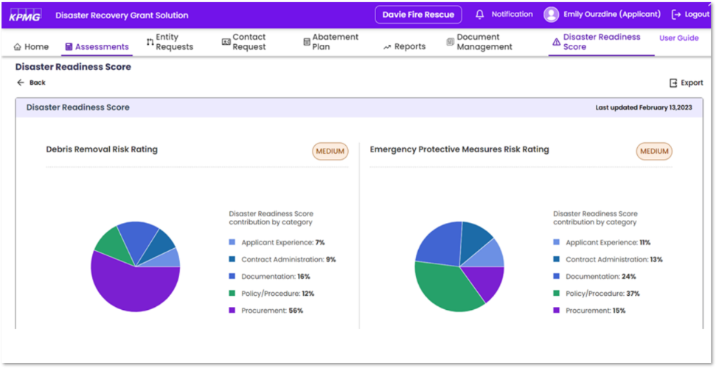
Disaster Readiness Assessment
BENEFITS OF COMPLETING THE DRA
Completing the DRA enables you to increase your overall F-ROC score, meaning you can recover a higher percentage of funding upfront in future events.
Completing the DRA enables you to identify risks in your organization.
Completing the DRA offers abatement plans to help address risks.
OUR ASK OF YOU
Set up your account in Smart Grants once you receive the email from donotreply-fldrgs@managedgrants.com.
Read through the DRA and understand what completing it entails.
Attend Information Sessions hosted by FDEM.
Review the DRA FAQ and ‘What is the DRA?’ 1 pager.
Proactively reach out to your Regional Recovery Coordinator if you need support.
Reach out to FDEM with any questions that you may have.
Work with others in your entity to complete the DRA.
Submit the DRA in Smart Grants before the deadline of 10/31.

Slide 9
DRA Process and RFI’s
FDEM validation review
Complete the DRA
Review with internal stakeholders
Receive DRA score
Once you have an initial score you can create an Abatement Plan
Gain access to the DRA
KPMG Smart Grants Platform access granted after opting in
02
Submit DRA
Once you have reviewed and completed questions
04
01
03
Once you have submitted your DRA, you may receive a RFI from the FDEM DRA Validators. The purpose of RFIs is to gather additional information or to clarify any ambiguities within your DRA responses so that FDEM can properly review and provide abatement activities.
If a RFI is issued based on your DRA responses, you will have 14 days to respond. We strongly encourage you to respond as quickly as possible. This will give us ample time to review your responses and review your DRA before you proceed with your abatement activities.

Slide 10
Access the Disaster Readiness Assessment (DRA) Form
DRA Resources to Support You
Are you having trouble submitting your Disaster Readiness Assessment? The following resources are available to support you as you navigate the DRA.
Review the DRA FAQ
We have compiled and responded to frequently asked questions on the Disaster Readiness Assessment
Click here to access the DRA FAQ.
Email us at
F-ROC@em.myflorida.com!
We are here to help resolve any roadblocks you may have and figure out what works best for you.
If you can’t attend an Information Session, watch a recorded DRA Information session.
Recordings of past information sessions are available on the FDEM website here.
Contact your Regional Recovery Coordinator for support.
Regional Recovery Coordinators are an excellent resource at each phase of your F-ROC journey.
See slide 19 for your RRC’s information.
DRA 1 Pager
This is an informative flyer that details key dates relating to the DRA, how it is structured, and the benefits of completing it.
Click here to access the DRA 1 Pager.

Slide 11
Abatement
MILESTONE OVERVIEW
Abatement is the last opportunity for your entity to enhance your readiness and increase your F-ROC score by selecting and completing abatement activities. After your Disaster Readiness Assessment is submitted in Smart Grants, the FDEM Validator team will conduct a thorough review of your responses. Once the FDEM Validator review is complete, you will receive an initial DRA score along with applicable abatement activities that are suggested based on your DRA responses.
There are two key deadlines associated with Abatement:
Deadline for submitting your Customized Abatement Plan to FDEM for review and approval.
  To meet this deadline, you need to review your DRA Validator feedback, select from the abatement activities to create your Customized Abatement Plan, and submit to FDEM in Smart Grants.
Deadline for completing your abatement activities and submitting to FDEM for review.
  To meet this deadline, you need to complete the abatement activities and upload the supporting documentation to Smart Grants for FDEM’s review and approval.
TIMELINE
After submitting your DRA
Once your DRA is submitted, it will go through FDEM Validator Review.
January 31
Deadline for submitting your Customized Abatement Plan to FDEM for review.
March 31
Deadline for completing your abatement activities and submitting to FDEM for review.

Slide 12
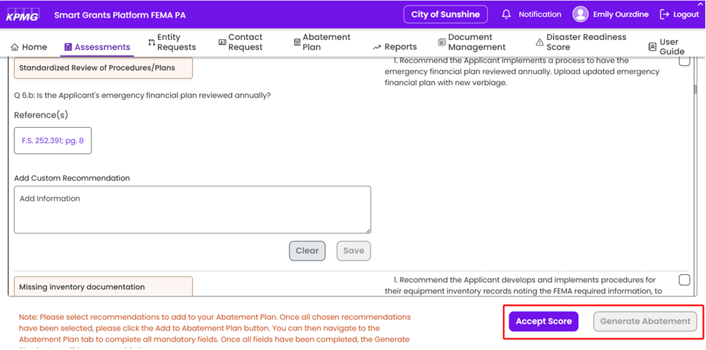

Customized Abatement Plan
OUR ASK OF YOU
Once your DRA is reviewed by FDEM, navigate to Smart Grants to view your initial score and feedback.
Download your ‘Disaster Readiness Assessment (State Validated)’ to see the feedback provided.
Review the Smart Grants – Abatement guide to initiate abatement and add abatement activities to your Customized Abatement Plan.
Once you have identified all the applicable abatement activities that you can complete before the deadline, submit your Customized Abatement Plan in Smart Grants.
BENEFITS OF COMPLETING ABATEMENT
Completing abatement enables you to increase your overall F-ROC score.
Completing abatement enables you to mitigate risks in your organization.
Completing abatement enables you to increase your preparedness for future events.

Slide 13
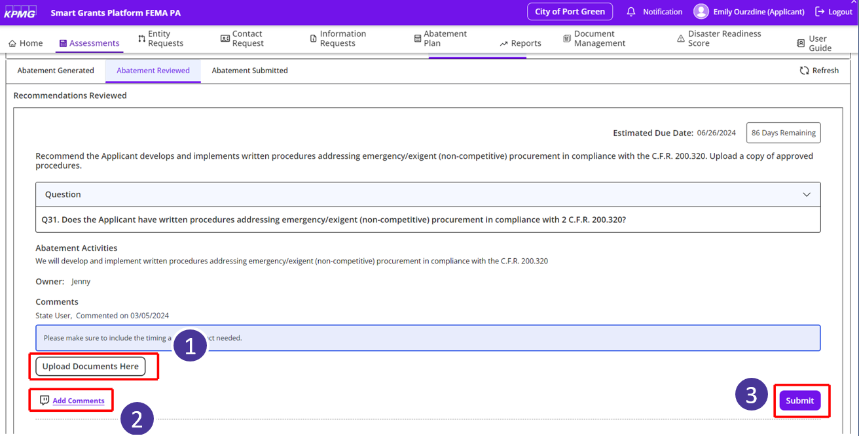
Completing Abatement Activities
OUR ASK OF YOU
Once FDEM reviews and approves your Customized Abatement Plan, begin working on completing your abatement activities.
Once your abatement activities are complete, submit the supporting documentation to FDEM for review and approval.
  We have created the Smart Grants – Documentation Guide to walk through how to upload documentation and clarifying comments in the Smart Grants platform. Review this guide to understand how to submit the necessary supporting documentation for FDEM review.

Slide 14
Abatement Process
FDEM validation review
Create your Customized Abatement Plan
Review the Smart Grants – Abatement Guide to understand how to initiate abatement in Smart Grants
Receive final
F-ROC score
Once FDEM reviews your completed abatement activities, FDEM will provide your final F-ROC score
Receive DRA score
Once you have a score, you can begin Abatement
02
Complete Abatement Activities
Complete abatement activities you have detailed in your Customized Abatement Plan
04
01
03

Slide 15
Abatement (Tips and Tricks)
If you are planning to complete abatement, do not select ‘Accept Score’ below. Selecting ‘Accept Score’ will bypass abatement and finalize your validated score.

Slide 16
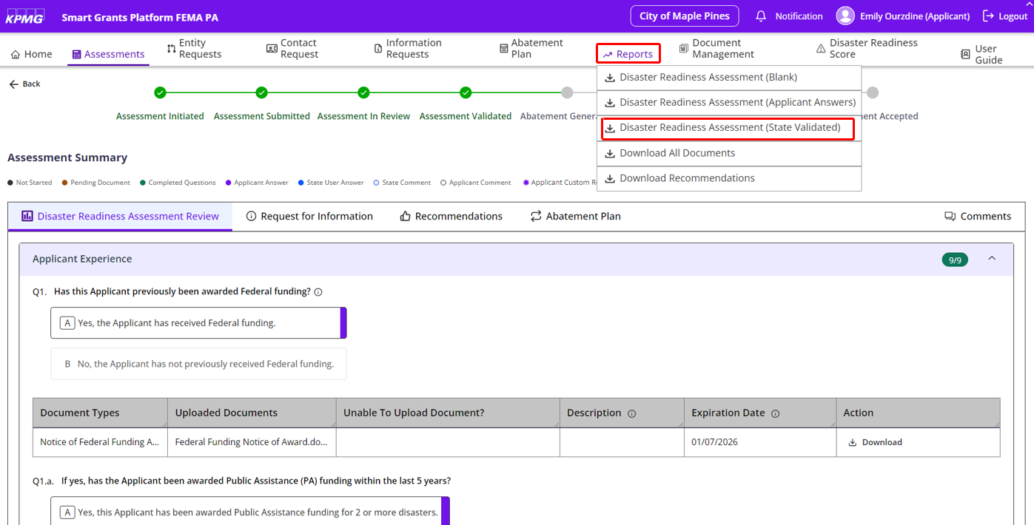
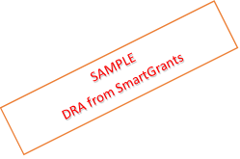
Abatement (Tips and Tricks)
Here’s how to navigate in SmartGrants to view direct feedback on your DRA:

Slide 17
Abatement Resources to Support You
Are you having trouble creating/submitting your Customized Abatement Plan or completing your Abatement Activities? The following resources are available to support you as you navigate abatement.
Access the Customized Abatement Plan Form
Review the Smart Grants – Abatement Guide
We have outlined the process to initiate abatement in Smart Grants once you have received your DRA Validator review.
Email us at
F-ROC@em.myflorida.com!
We are here to help resolve any roadblocks you may have and figure out what works best for you.
Contact your Regional Recovery Coordinator for support
Regional Recovery Coordinators are an excellent resource at each phase of your F-ROC journey.

Slide 18
Post Disaster Questionnaire (PDQ)
MILESTONE OVERVIEW
BENEFITS OF COMPLETING THE PDQ
The Post Disaster Questionnaire (PDQ) is a questionnaire that is deployed after an event that aims to identify how program participants leveraged F-ROC materials. The PDQ seeks to understand if participants used any of FDEM’s standardized forms and which ones, if participants attended any F-ROC training and if the entity is EMAP accredited. Completing the PDQ can increase your F-ROC score by up to 25 points.
There will be one PDQ deployed for every Federally declared event that happens. For example, if there are two hurricanes, there will be two corresponding PDQ’s, and you may have two different F-ROC scores based on your PDQ responses.
Completing the PDQ enables you to increase your overall F-ROC score by up to 25 points.
OUR ASK OF YOU
After an event, once the PDQ has gone live and you have completed your request for public assistance, log in to Smart Grants to complete the PDQ.
Open the PDQ and respond to all questions, identifying F-ROC trainings you have attended and forms you have leveraged.
Submit the PDQ in Smart Grants.
TIMELINE
Following an Event
Within 10 days after an event, a PDQ will go live in Smart Grants for applicants to complete.
Event + 60 Days
Applicants will have 60 days after an event to complete the PDQ in Smart Grants.
Once PDQ is submitted
FDEM will review PDQ answers and determine final F-ROC score for the event.

Slide 19
PDQ Process
FDEM review
PDQ Goes Live in Smart Grants
Receive PDQ score and overall F-ROC score for the event
An event/disaster occurs
The PDQ is specific to an event. If there are 2 storms, there will be 2 PDQ’s.
02
Applicant completes PDQ in Smart Grants
04
01
03

Slide 20
PDQ Resources to Support You
Are you having trouble completing/submitting your Post Disaster Questionnaire or your Abatement Activities? The following resources are available to support you as you navigate the PDQ.
Access the Post Disaster Questionnaire (PDQ) Form
on the F-ROC Website
Review the Smart Grants – PDQ Guide
We have outlined the process to complete the PDQ in Smart Grants.
Email us at
F-ROC@em.myflorida.com!
We are here to help resolve any roadblocks you may have and figure out what works best for you.
Contact your Regional Recovery Coordinator for support
Regional Recovery Coordinators are an excellent resource at each phase of your F-ROC journey.

Slide 21
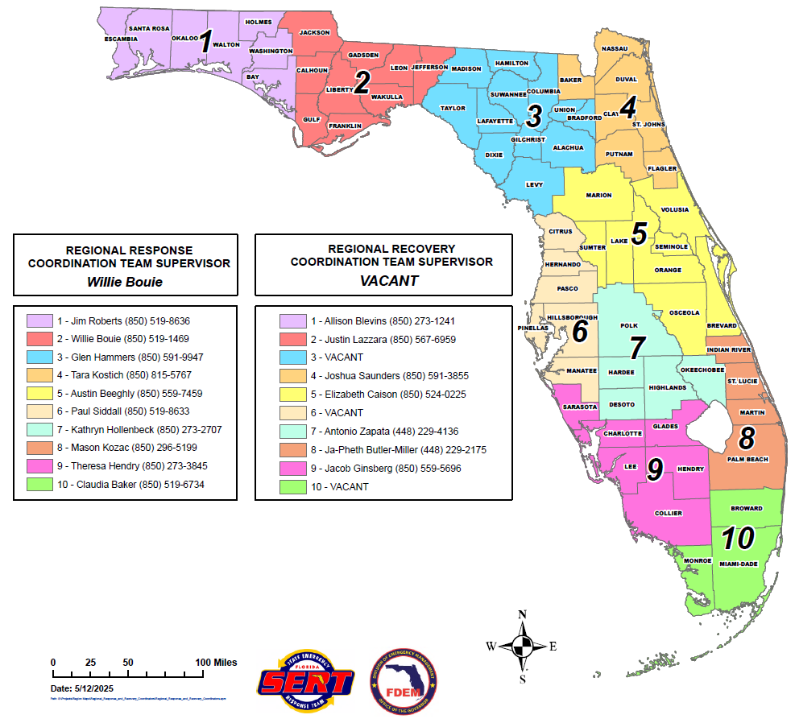
Regional Coordinators
Regional Response and Recovery Coordinators can help to support you and answer your F-ROC questions. See below for the Regional Coordinators in your region.

Slide 22
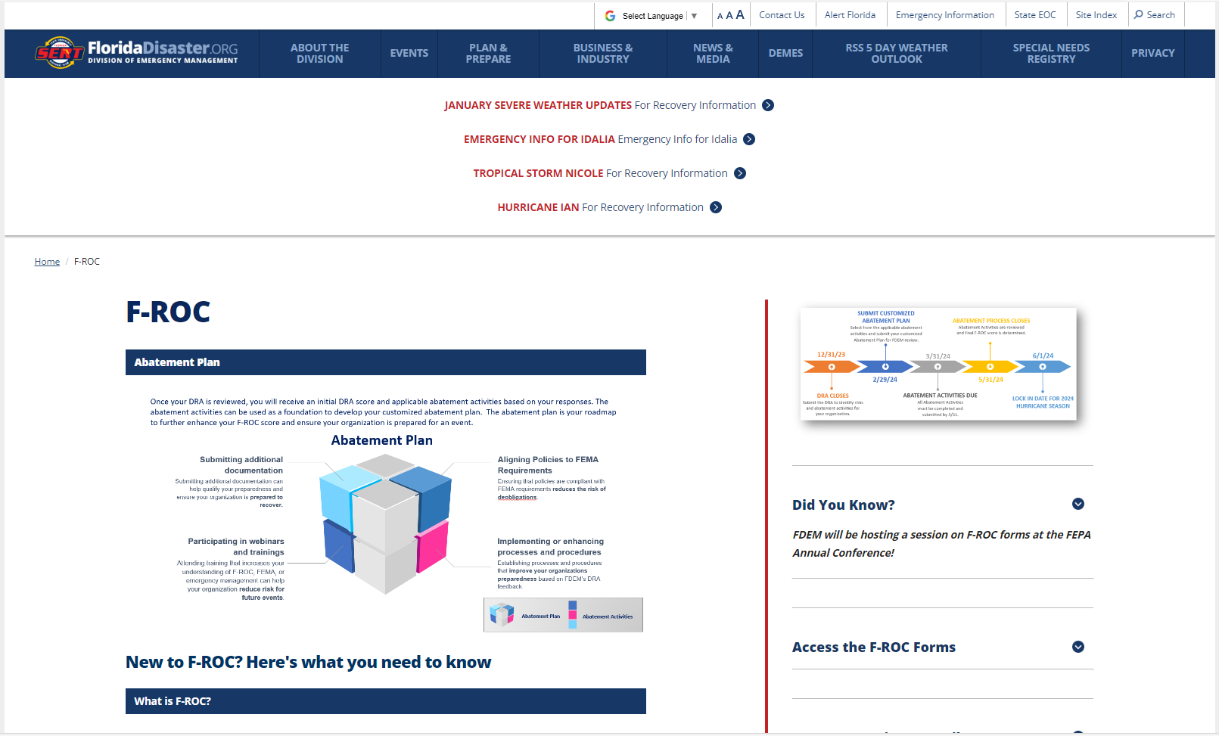
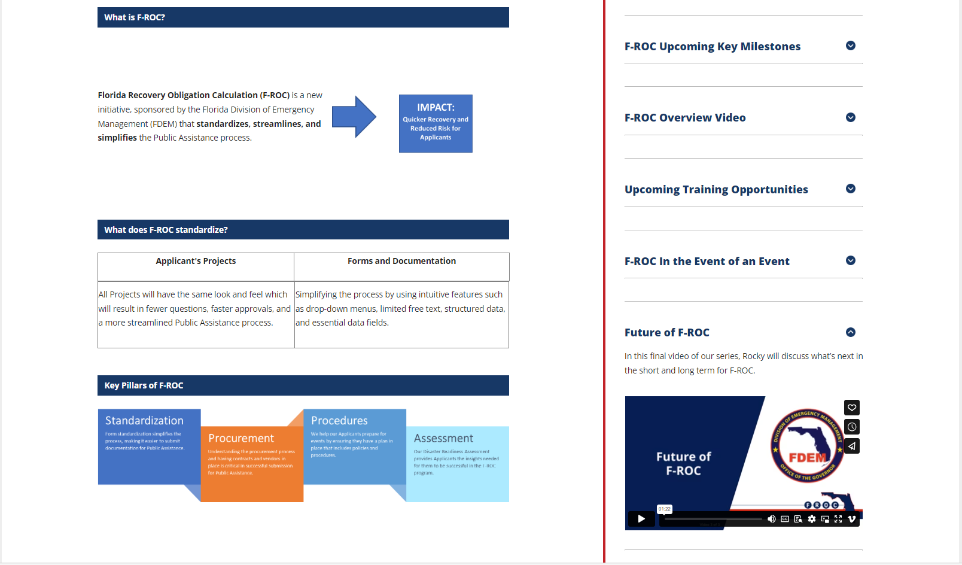
F-ROC Website
The F-ROC website, F-ROC | Florida Disaster is a great resource if you need additional support or information about all things F-ROC. We regularly update the F-ROC website and ensure it contains timely information that you need at each F-ROC milestone.
E-Learning Videos
Upcoming Training Opportunities
Timely information on next key milestone
The Future of F-ROC
F-ROC Overview Information
Access the F-ROC Forms

